Slide 1

Image Classification Project
Submitted by:
Shama Tanweer

Slide 2
Introduction
Nowadays internet is filled with an abundance of images and videos, which is encouraging the development of search applications and algorithms that can examine the semantic analysis of image for presenting the user with better search content and their summarization.Manually checking and classifying images could be a tedious task especially when they are massive in number . Image classification refers to a process in computer vision that can classify an image according to its visual content. It involves the extraction of information from an image and then associating the extracted information to one or more class labels
Recently, image classification is growing and becoming a trend among technology developers especially with the growth of data in different parts of industry such as e-commerce, automotive, healthcare, and gaming. For example,Whenever users upload a photo, Facebook is able to recognize objects and scenes in it before people enter a description

Slide 3
Problem statement
The idea behind this project is to build a deep learning-based Image Classification model on images that will be scraped from e-commerce portal

Slide 4
Analytical Problem Framing
We have scraped images of all 3 classes that is men jeans, men trouser and saree from amazon.com and we have built our model by training it on this data.
We have used transfer learning to get state of the art results for our model.
Data has been scraped from amazon.com using a python script which with selenium. All the data is in the .jpg image format.
We have over 305 images per class

Slide 5
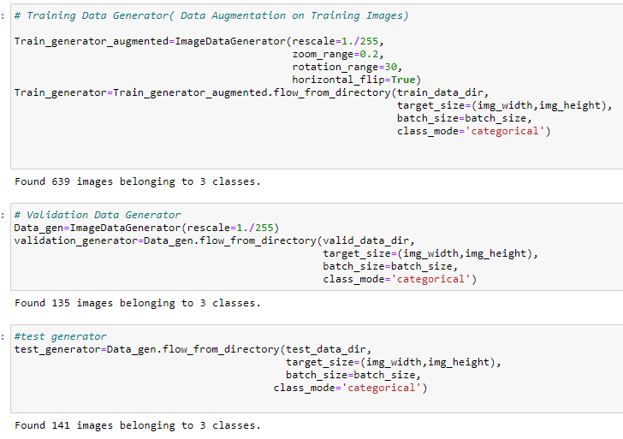
Data Augmentation

Slide 6
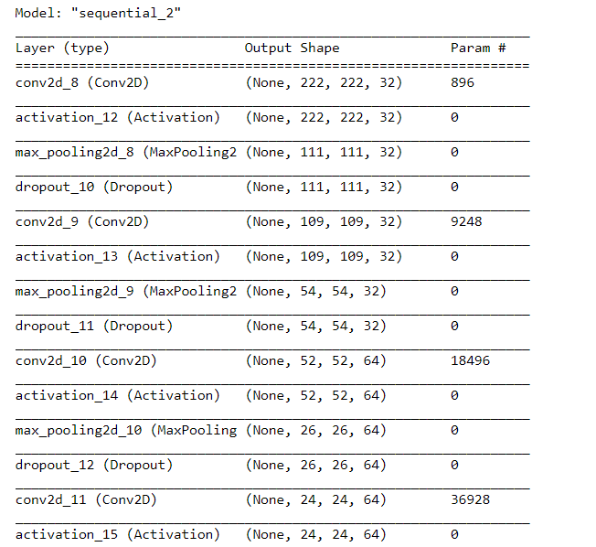
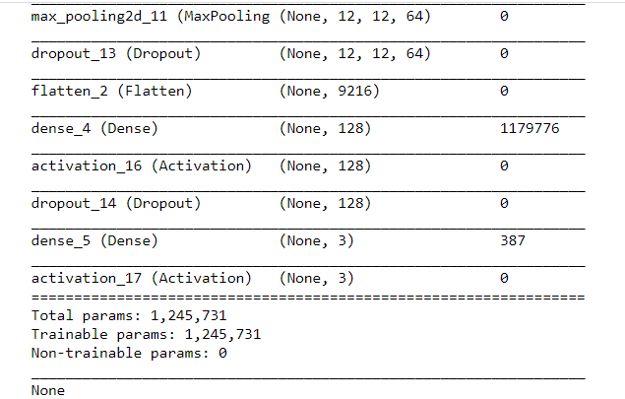
MODEL SUMMARY

Slide 7
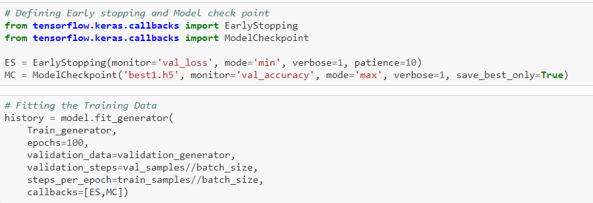
Defined Early Stop criteria and saved the model as ‘best.h5’ for the best results

Slide 8
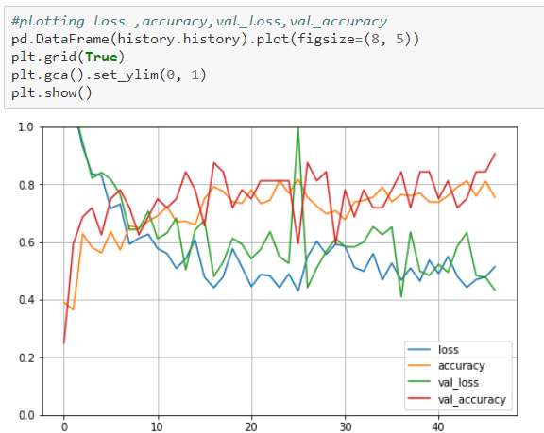

Slide 9
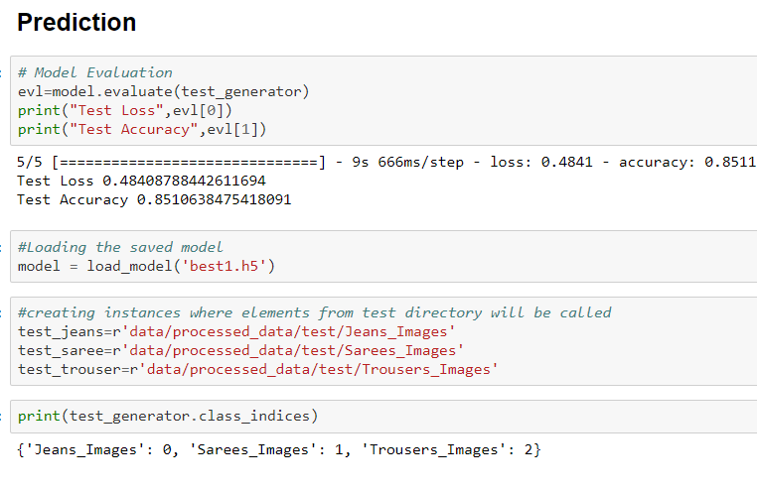

Slide 10
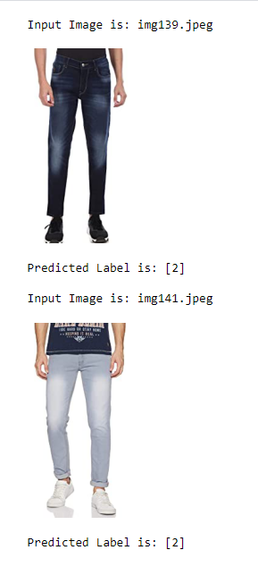
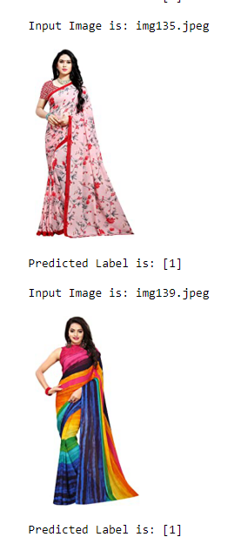
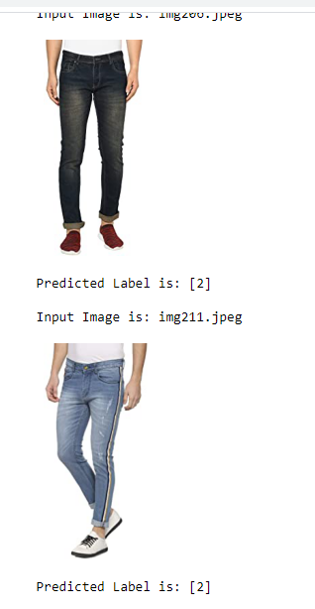
Predicted Image

Slide 11
CONCLUSION
Key Findings and Conclusions of the Study
Images pulled from data directory had different shapes which need to be handled to prepare our model.
Model gives 85% test accuracy.
The accuracy can be enhanced by using more training images. Here, I have used 305 images per category which can be increased to 1000 per category to give more training data
Learning Outcomes of the Study in respect of Data Science
Image augmentation was very helpful technique to generate the real augmented data which can be used for various purpose.
Concept of early stopping was excellent since it could save a lot of time in case of huge datasets

Slide 12
Thank YOU

